Slide 1

Progress Presentation
Mai, Maia, Oliver

Slide 2
Research Question
Does religious affiliation affect hate crime in the United States?
Religious Affiliation: density of religious sites
Hate Crime: "a crime, typically one involving violence, that is motivated by prejudice on the basis of ethnicity, religion, sexual orientation, or similar grounds."

Slide 3

Motivation
The Leadership Conference for Education Fund reports
“Each of the last four presidential election periods have shown an unmistakable pattern: Hate crimes increase during elections.”
Anti-LGBT Hate Crimes “increased by 54 percent from 2020 to 2021”
“Movements grounded in attempts to whitewash history and deny the rights of the LGBTQ+ community have turned hate into campaign platforms.”

Slide 4
Data Collection
FBI Hate Crime Data
Church Data
Church Affiliation Data
State Population Data

Slide 5
FBI Hate Crime Data
Biases
Anti-Black or African American
Anti-White
Anti-Arab
Anti-Protestant
Anti-Islamic (Muslim)
Anti-Gay (Male)
Anti-Asian
Anti-Catholic
Anti-Multiple Religions, Group
Anti-Hispanic or Latino
Anti-Lesbian (Female)
Anti-Other Race/Ethnicity/Ancestry
Anti-Jewish
Anti-American Indian or Alaska Native
Anti-Lesbian, Gay, Bisexual, or Transgender (Mixed Group)
Anti-Heterosexual
Anti-Atheism/Agnosticism
Anti-Bisexual
Anti-Physical Disability
Anti-Mental Disability
Anti-Jehovah's Witness
Anti-Church of Jesus Christ
Anti-Buddhist
Anti-Sikh
Anti-Other Christian
Anti-Hindu
Anti-Eastern Orthodox (Russian, Greek, Other)
Anti-Transgender
Anti-Gender Non-Conforming
Anti-Male
Dataset collected from the FBI tracking every minority biased hate crime in the United States from 1991-2022.
Dataset was filtered to only include Anti-LGBT crimes from 2014-2022 after visualizing the drastic rise in anti-LGBT crime during this period.
Parameters:
Year
Bias description
Population Description
State
Incident Date
Offender Race
Offense Name/Type

Slide 6
All Places of Worship GIS Data
Dataset collected from All Places of Worship and provides GIS data on every church in the United States in 2020
254,742 sample units
Data was aggregated on the State level to get a sum of number of churches in each US State
Parameters:
State
Number of Churches

Slide 7
Church Affiliation Data
Dataset scraped from Pew Research from a survey of 35,000 Americans in 2014 around the country finding the distribution of religious affiliations in the US.
Observations: 50 US States (rows)
Parameters – Percentages of each state identifying as:
Buddhist
Catholic
Evangelical
Hindu
Historically Black Protestant
Jehovah's Witness
Jewish
Mainline Protestant
Mormon
Muslin
Orthodox Christian
Other Christian
Other Faiths
Other World Religions
Unaffiliated
Don’t Know
Sample Size

Slide 8
State Population Data
US Census data from 2020 for the population of each US state
Observations: 50 US States
Parameters: Population for the years:
2014
2015
2016
2017
2018
2019
2020
2021
2022

Slide 9
Final Data Frame
Hate Crime Data
# of Hate Crimes
Keys
State
Year
Population Data
State Populations
# of Churches by Affiliation
Church Data
# of Churches
Affiliation Data
Percentage of each religion

Slide 10
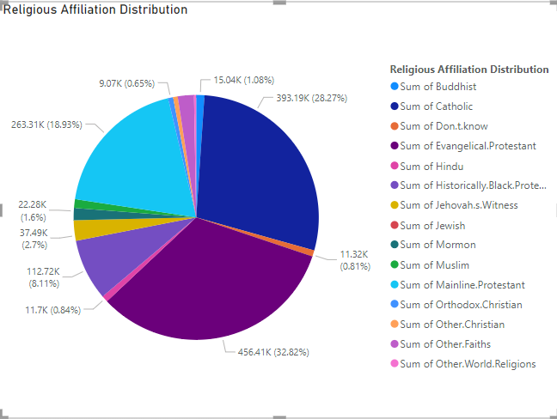
EDA
Examine which religious affiliation is the majority -> Any discrepancy in each affiliation’s supposedly correlation with total hate crimes?

Slide 11
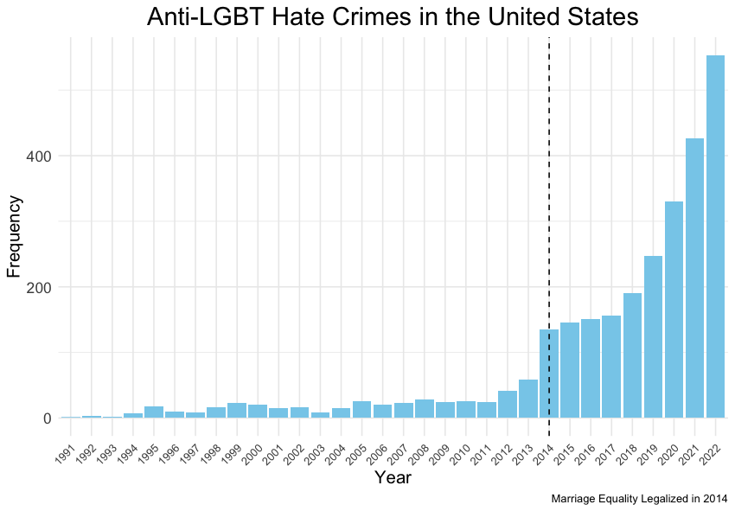

Slide 12
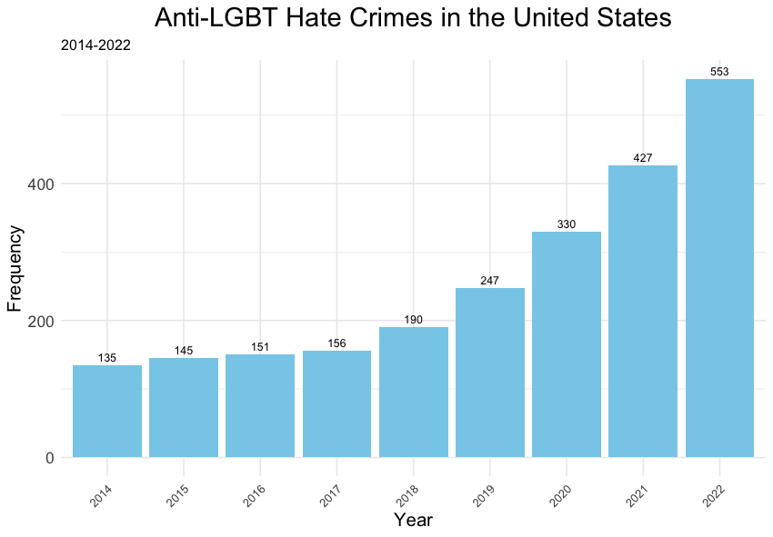

Slide 13
Model Idea
Controlled variables
Religious Affiliation: Different religious affiliations may have varying beliefs and attitudes towards LGBTQ+ individuals, influencing the prevalence of anti-LGBT hate crimes
Political Climate: Areas with a higher concentration of Republican voters or conservative political leadership may be more likely to enact anti-LGBT legislation or promote discriminatory attitudes towards LGBTQ+ individuals.
Church Density/ Religious Sites Density: reflect the prevalence of religious communities within a region and their potential impact on social attitudes and behaviors. Areas with higher church density may exhibit stronger adherence to traditional values and beliefs, which could contribute to higher levels of prejudice or discrimination towards LGBTQ+ individuals.
- Same-Sex Marriage Legalization, or Legislation in favor of minority groups in general.

Slide 14
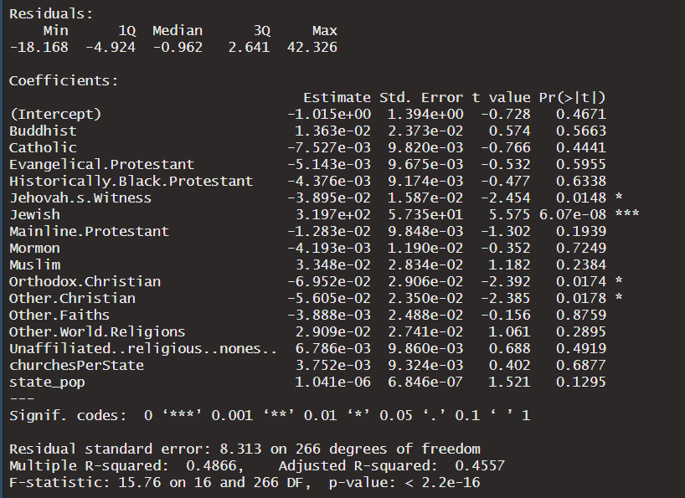
Model
hate_crime = b0 + b1*religious_affliation +b2*religious_site_density+ b3*state_pop (+ b4*voting_results)

Slide 15
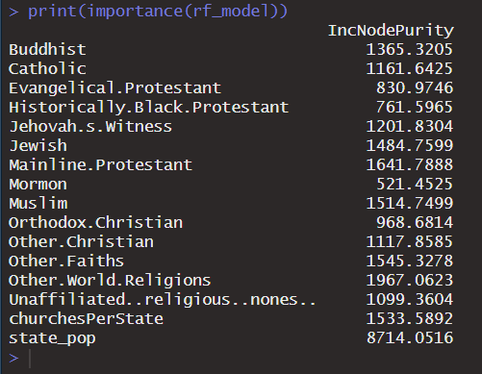
Random Forest
Helps identify which predictors have the most influence on predicting hate crimes.
Higher values indicate greater importance in predicting the response variable
State Population seems to have the highest effect here. However, Mainline.Protestant, Muslim, Buddhist, and Jewish are also high up the list.

Slide 16
Implications
Religious affiliation can be hard to quantify – accuracy of the data
Hate crime data is prone to underrepresentation
Understanding the relationship between hate crime and religiosity can lead to stigmatization of certain religions
Depending on the use of the information!

Slide 17
Next Steps
Creating a dashboard!
Add more variables to further define our model and understand the relationships at play
Voting patterns
Immigration rates
Political climate (prevalence of each party)
Amount of anti-LGBTQ+ legislation passed in the area
Demographic variables: race, income, gender, etc.
Attempt to break into county-level data

Slide 18
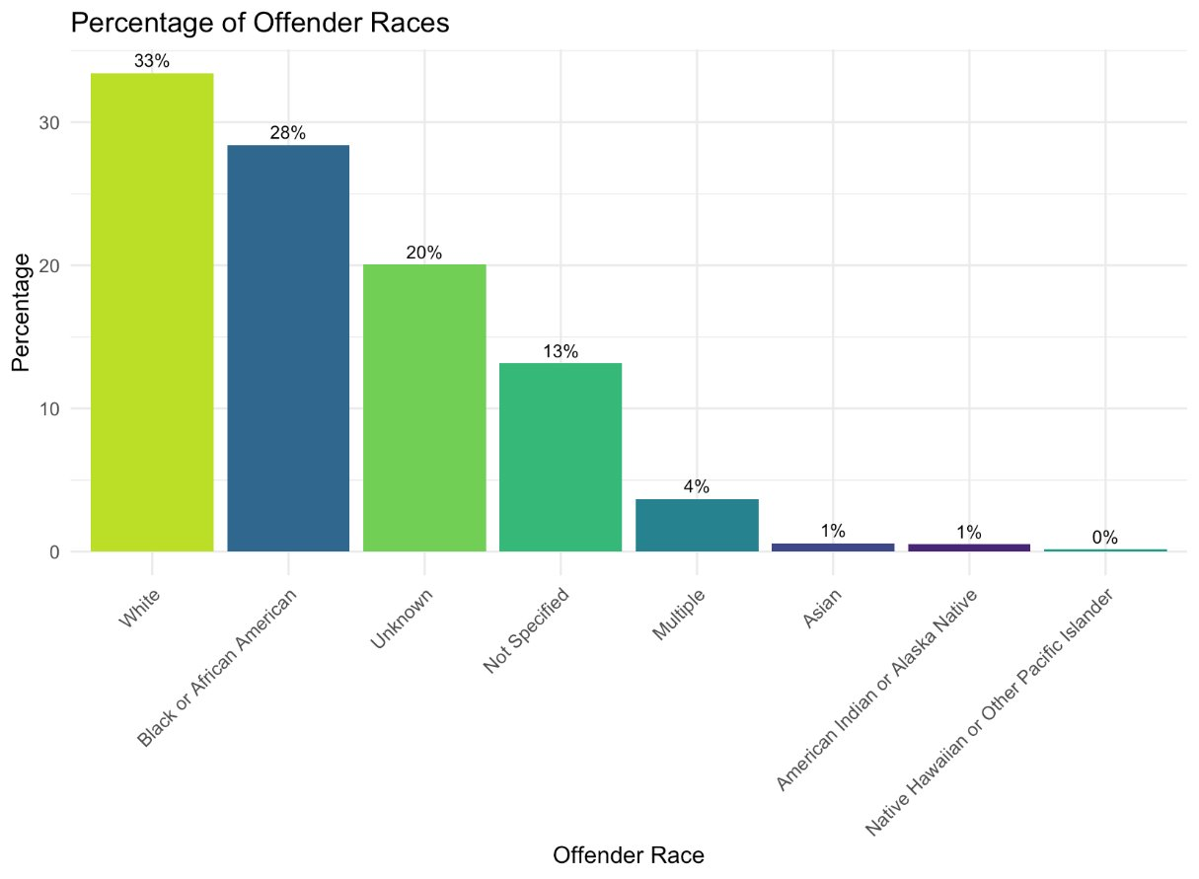
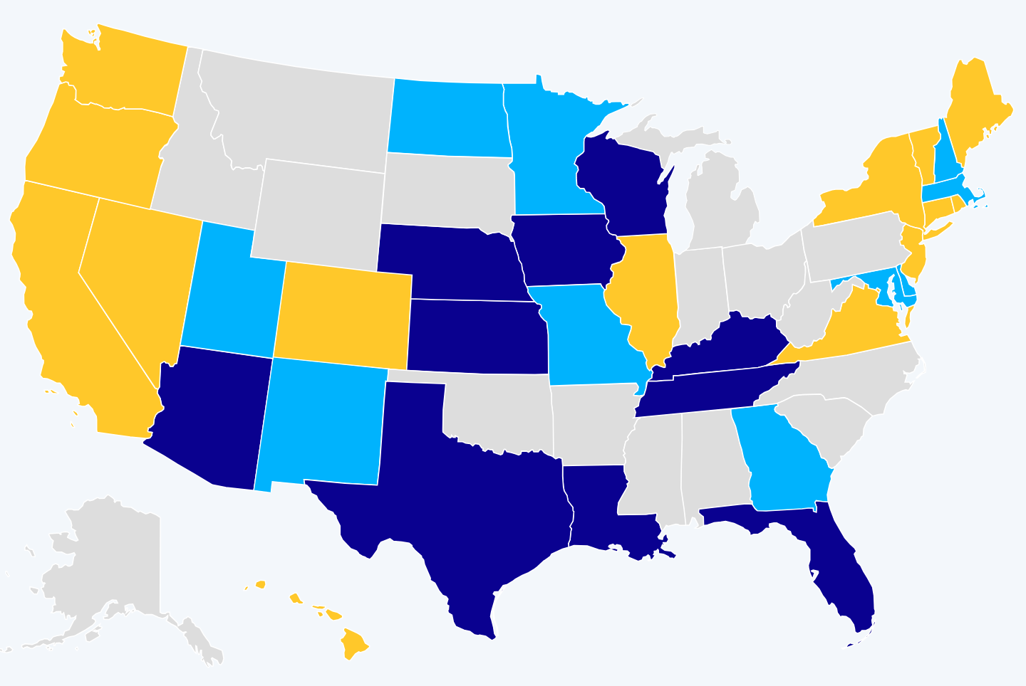
Inspiration for Adding Additional Variables
US State Legislation (HRC)
Consider only sexual orientation when addressing hate crimes
Consider sexual orientation and gender identity when addressing hate crimes
Have a law that eliminates bias rage
Has hate crime laws that lack any LGBTQ+ inclusion

Slide 19
Thank You!

